Slide 1

Introduction to React
Lesson 3 – MR. Dong, Bui Huu

Slide 2
Objectives
Overview Front-end JavaScript frameworks and libraries
Understand the architecture of an React application
Scaffold out a starter React application using create-react-app, the command line tool

Slide 3

Overview Front-End JavaScript Frameworks and Libraries

Slide 4
Library vs Framework
The following borrowed from AngularJS documentation makes the distinction clear:
a library - a collection of functions which are useful when writing web apps. Your code is in charge and it calls into the library when it sees fit. E.g., jQuery.
frameworks - a particular implementation of a web application, where your code fills in the details. The framework is in charge and it calls into your code when it needs something app specific. E.g., Angular, Ember, etc.
https://docs.angularjs.org/guide/introduction

Slide 5
JavaScript Frameworks
Single Page Application
Rich Internet Applications
Model-View-Controller (MVC) / Model-View- ViewModel (MVVM) / Model-View-Whatever
Data binding, routing
Scalable, Reusable, Maintanable JS code
Test driven development

Slide 6
JavaScript Frameworks/Libraries
Angular
Ember
Backbone
React
Aurelia
Meteor
Polymer
Knockout
Vue
Mercury

Slide 7

Don’t Overreact
So, is React a Library or a Framework?

Slide 8
Introduction to React

Slide 9
What is React?
A JavaScript library for building user interfaces
Declarative
Component-based
Technology stack agnostic

Slide 10
React History
React
Designed by Jordan Walke
First deployed on Facebook's newsfeed in 2011
Open-sourced at JSConf US in May 2013
Designed for speed, simplicity, and scalability
https://en.wikipedia.org/wiki/React_(JavaScript_library)

Slide 11
React Vocabulary
One-way data flow
JSX
Components
State
Props
Virtual DOM
Element
Flux / Redux
Testing

Slide 12
Exercise 5: Getting Started with React
Install create-react-app
Scaffold out a basic React application

Slide 13
React Application Overview

Slide 14
React Element
Smallest building blocks of React apps
const element = <h1 className="App-title">Welcome to React</h1>;
Plain JS objects that are
Cheap to create
Components are “made of” elements
class App extends Component { . . . }

Slide 15
Rendering to the DOM
Rendered using ReactDOM. See index.js
ReactDOM.render(<App />, document.getElementById('root’));
Where is it rendered? See index.html
<div id="root"></div>
Root DOM node

Slide 16
Introduction to JSX

Slide 17
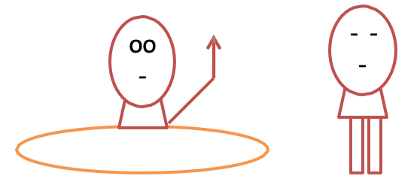
Introduction to JSX
const element = <h1>Hello, world!</h1>;
Waiter, what’s this HTML tag doing in my code?
Notes:
Cú pháp thẻ này không phải là một chuỗi kí tự cũng không phải là một thẻ HTML

Slide 18
JSX
Syntactic extension to JavaScript
Shorthand notation to represent JavaScript functions calls that evaluate to JavaScript objects
Avoids artificial separation of rendering logic from other UI logic
Notes:
Nó được gọi là JSX, là một cú pháp mở rộng cho JavaScript. React khuyến khích sử dụng JSX để mô tả giao diện (UI). JSX có thể trông giống Ngôn ngữ Khuôn mẫu (Template language), nhưng JSX đi kèm với toàn bộ tính năng của JavaScript.

Slide 19
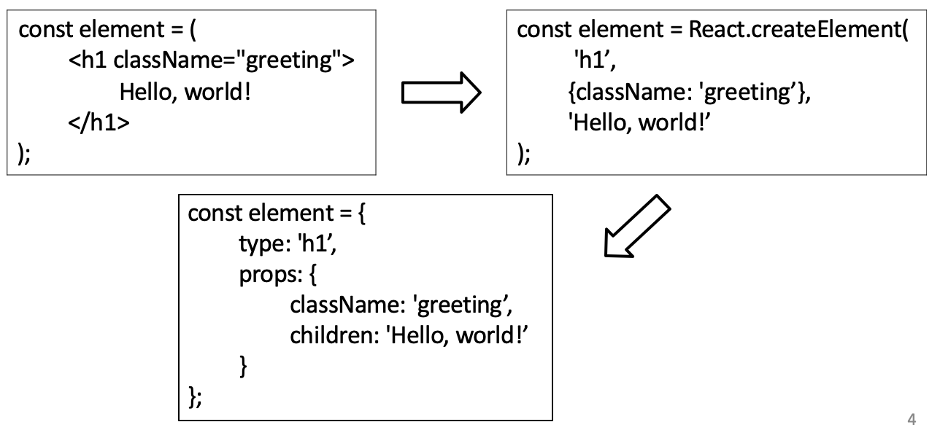
JSX
Notes:
JSX cho ra những “phần tử”(Element) React.

Slide 20
Embedding Expressions in JSX
const dish = { id: 0, name:'Uthappizza’, . . .};
return (
<div key={dish.id} className="col-12 mt-5">
<Media tag="li">
<Media body className="ml-5">
<Media heading>{dish.name}</Media>
</Media>
</Media>
</div>
);
Notes:
Bạn có thể nhúng bất kỳ biểu thức JavaScript hợp lệ bên trong JSX bằng cặp dấu ngoặc nhọn.
JSX cũng là một biểu thức, tức là có thể dùng JSX bên trong câu lệnh if cũng như vòng lặp for, gán nó cho biến, dùng như tham số hàm, và trả về JSX từ hàm.

Slide 21
Summary
Overview Front-end JavaScript frameworks and libraries
Understand the architecture of an React application
Scaffold out a starter React application using create-react-app, the command line tool

